Slide 1
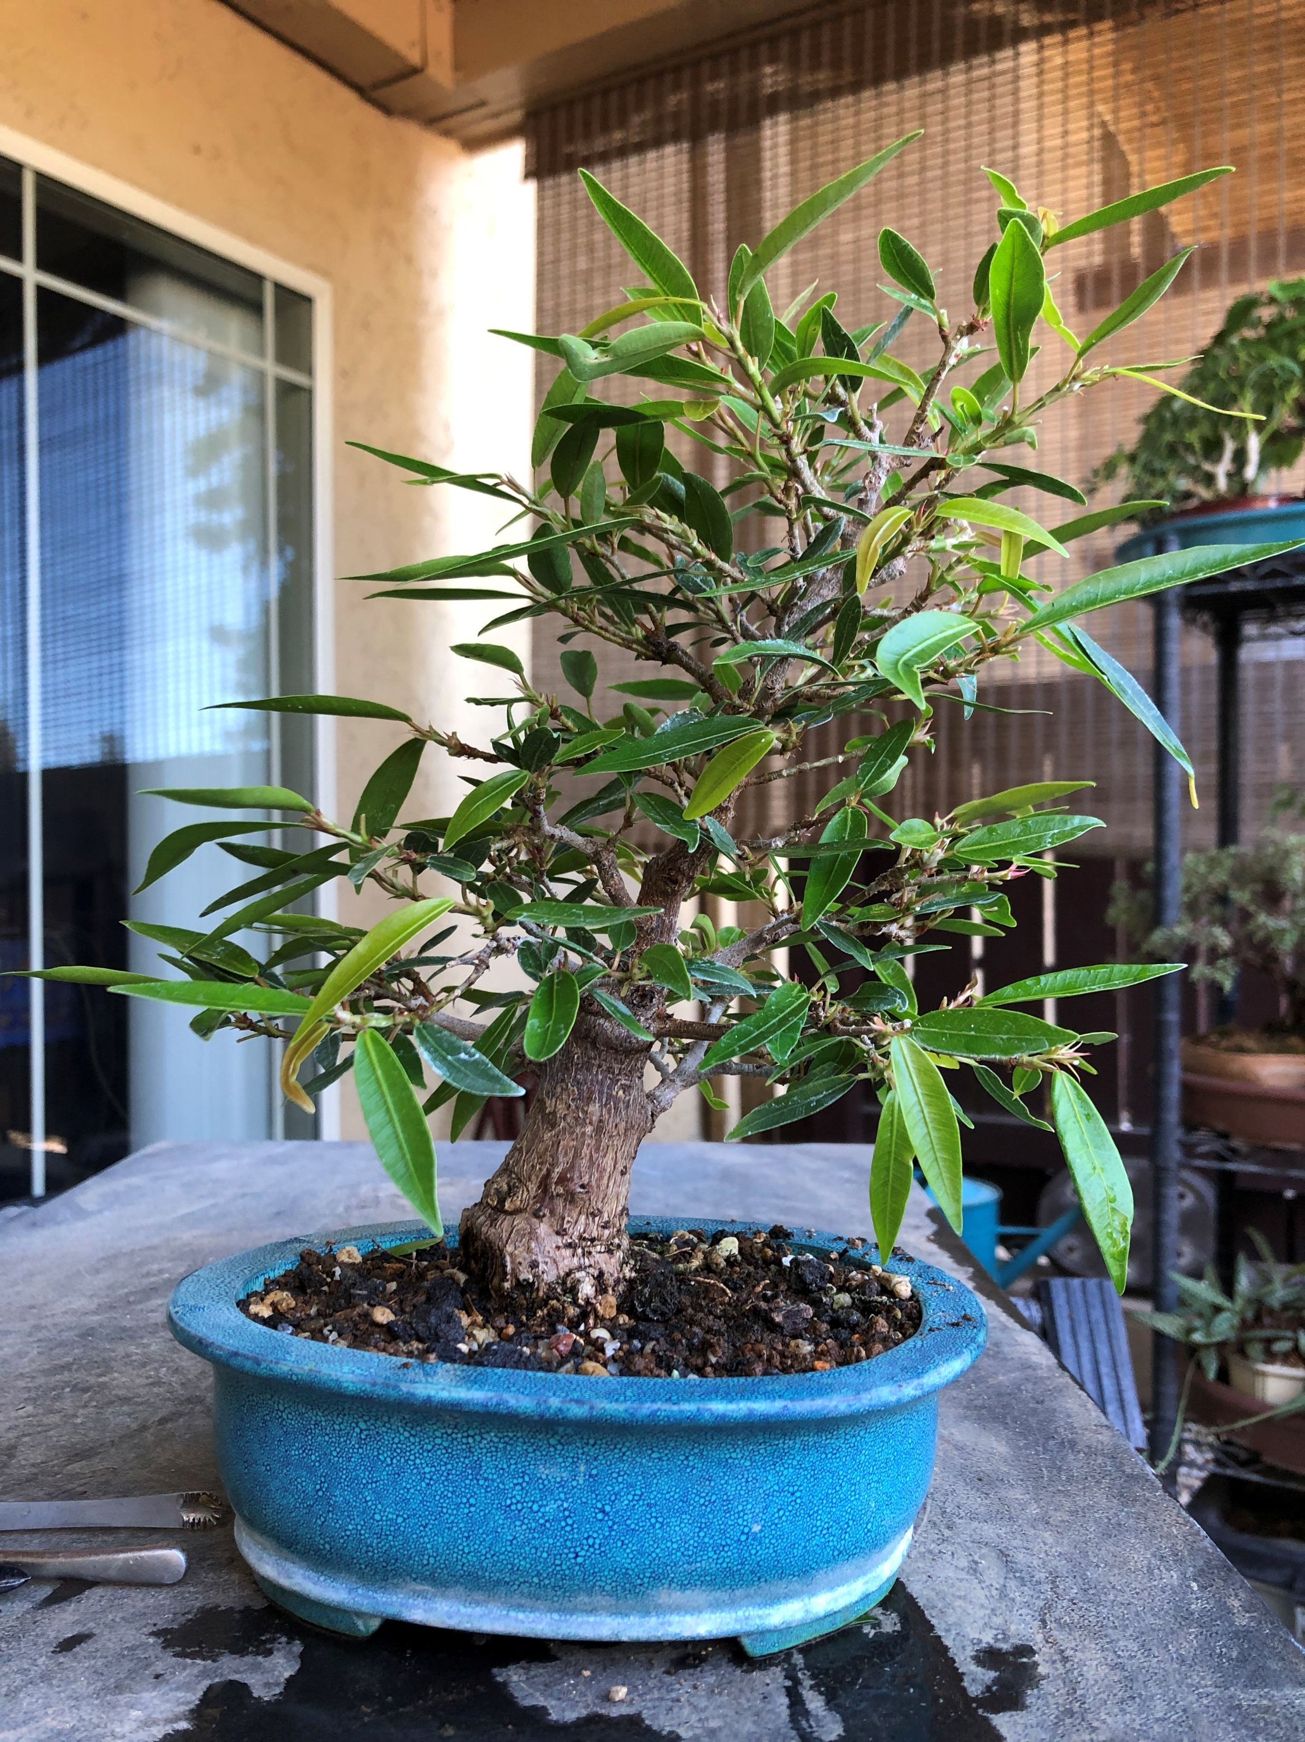
Tropical Development
Summer 2020
By
Jerry Carpenter

Slide 2
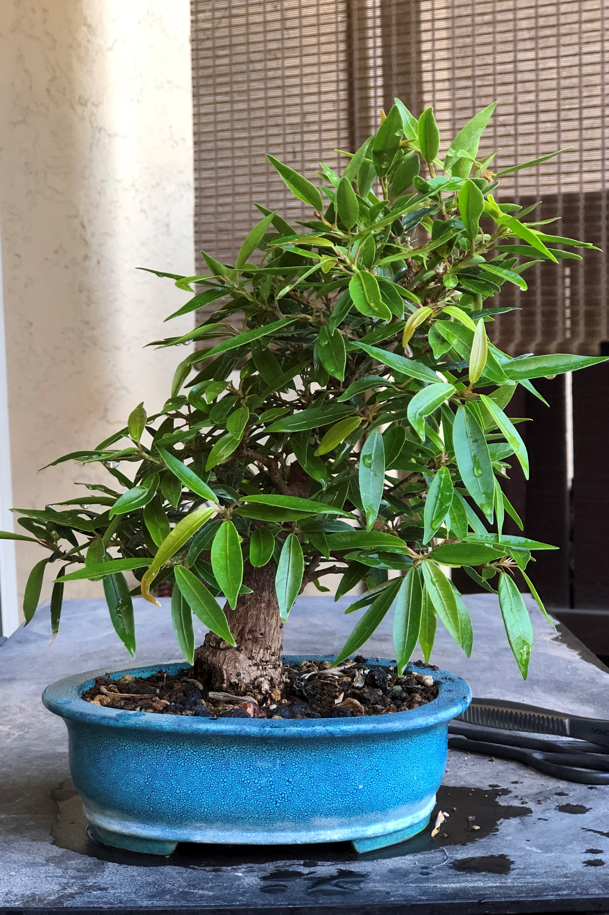
Ficus Nerifolia
Full foliage. Leaving the tree full will cause internal branch loss.
Common insect is Thrips

Slide 3
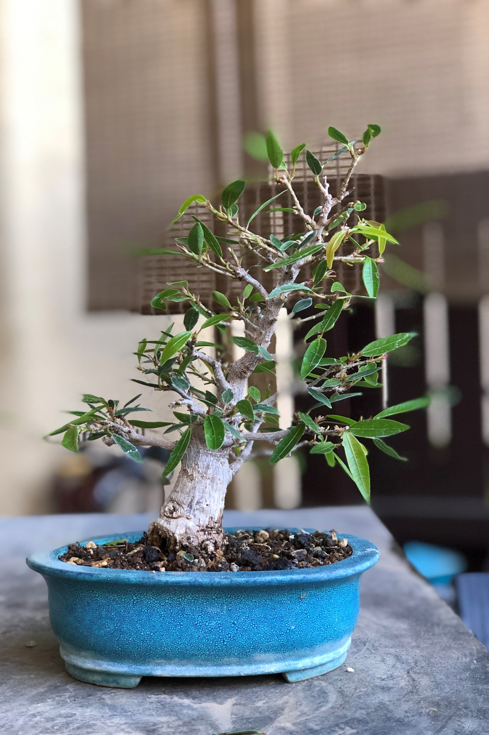
“Willow Leaf” Ficus
After clean out of foliage.
It has now redeveloped.

Slide 4
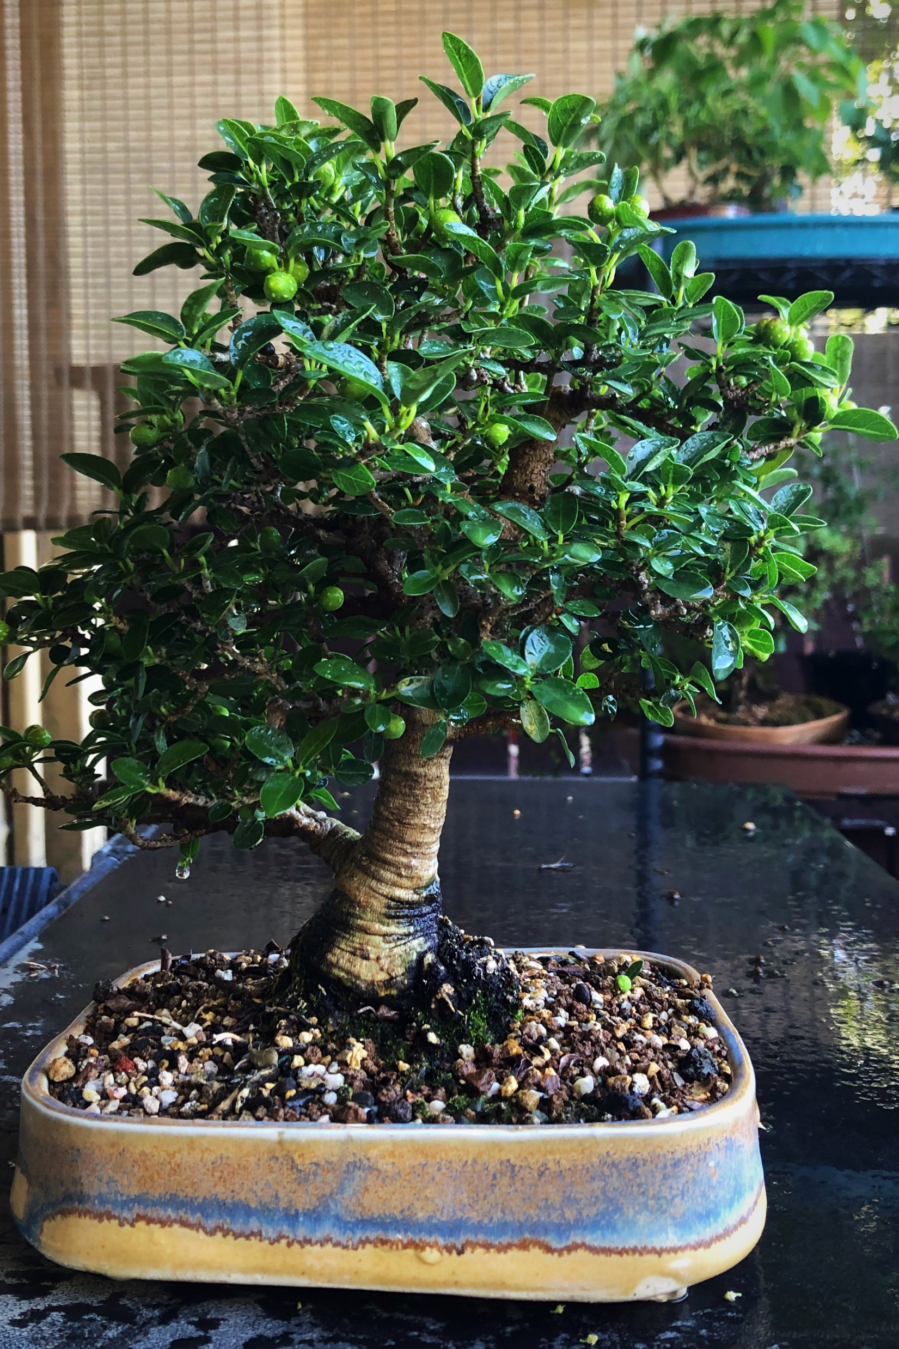
Ficus burtt-davyi
Shohin, Reduced last year and now full
of figs.
We do not have the wasp required to sting the fruit to make them fertile.

Slide 5
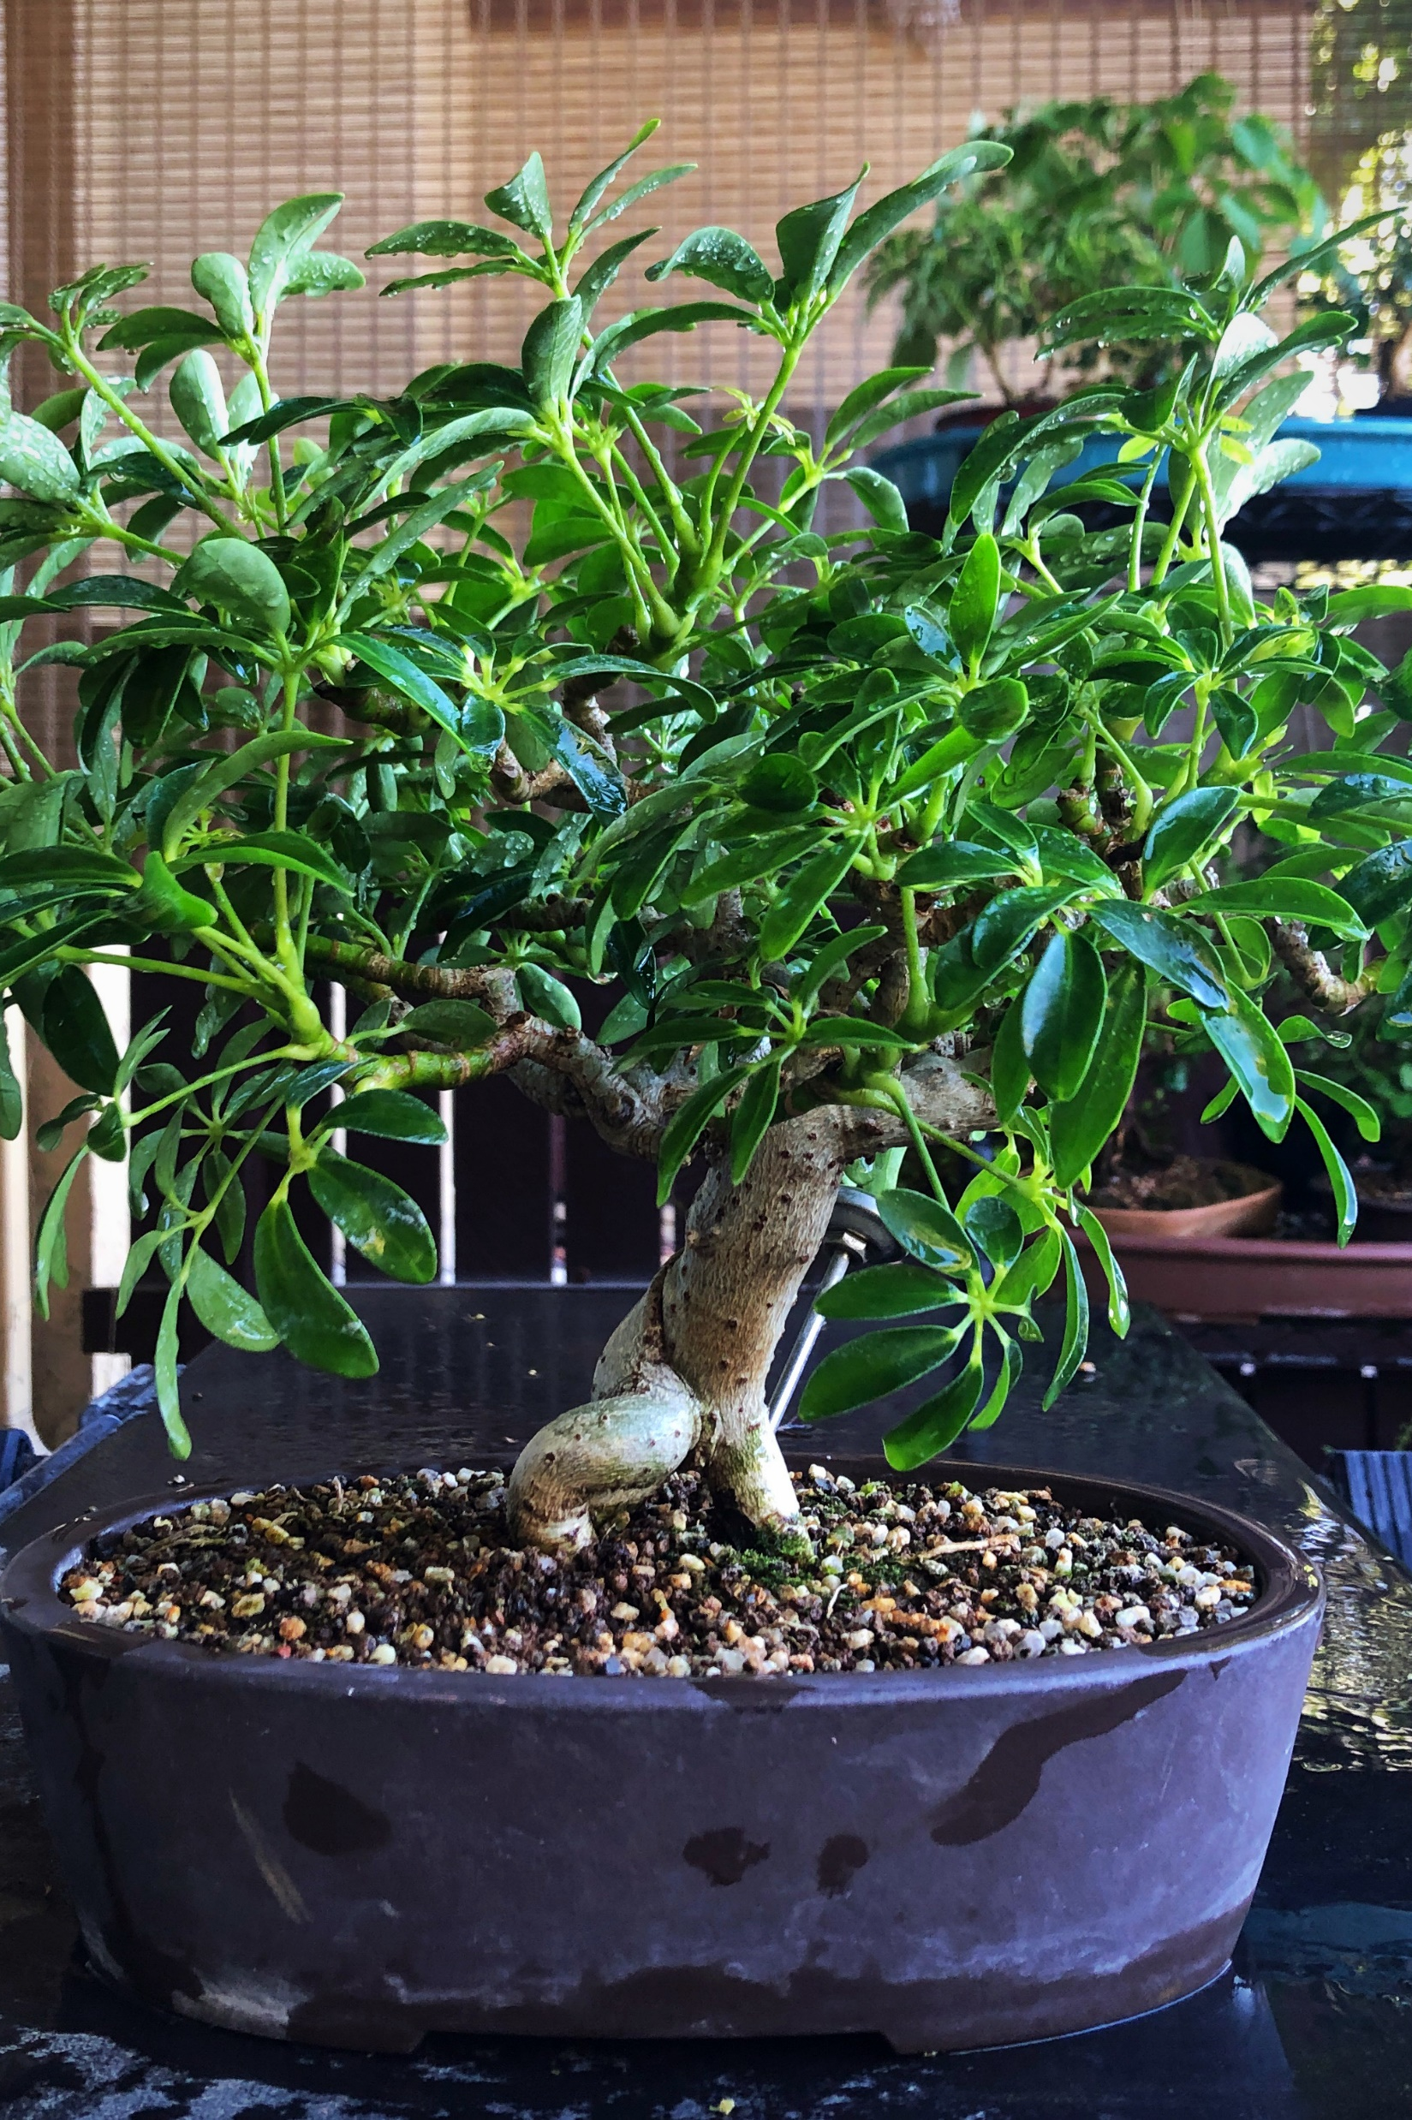
Schefflera
Trunk is thickening up well now.
This was OSH discovery many years ago. This image shows the leaves rather large because I am letting it put energy into roots in this new pot.

Slide 6
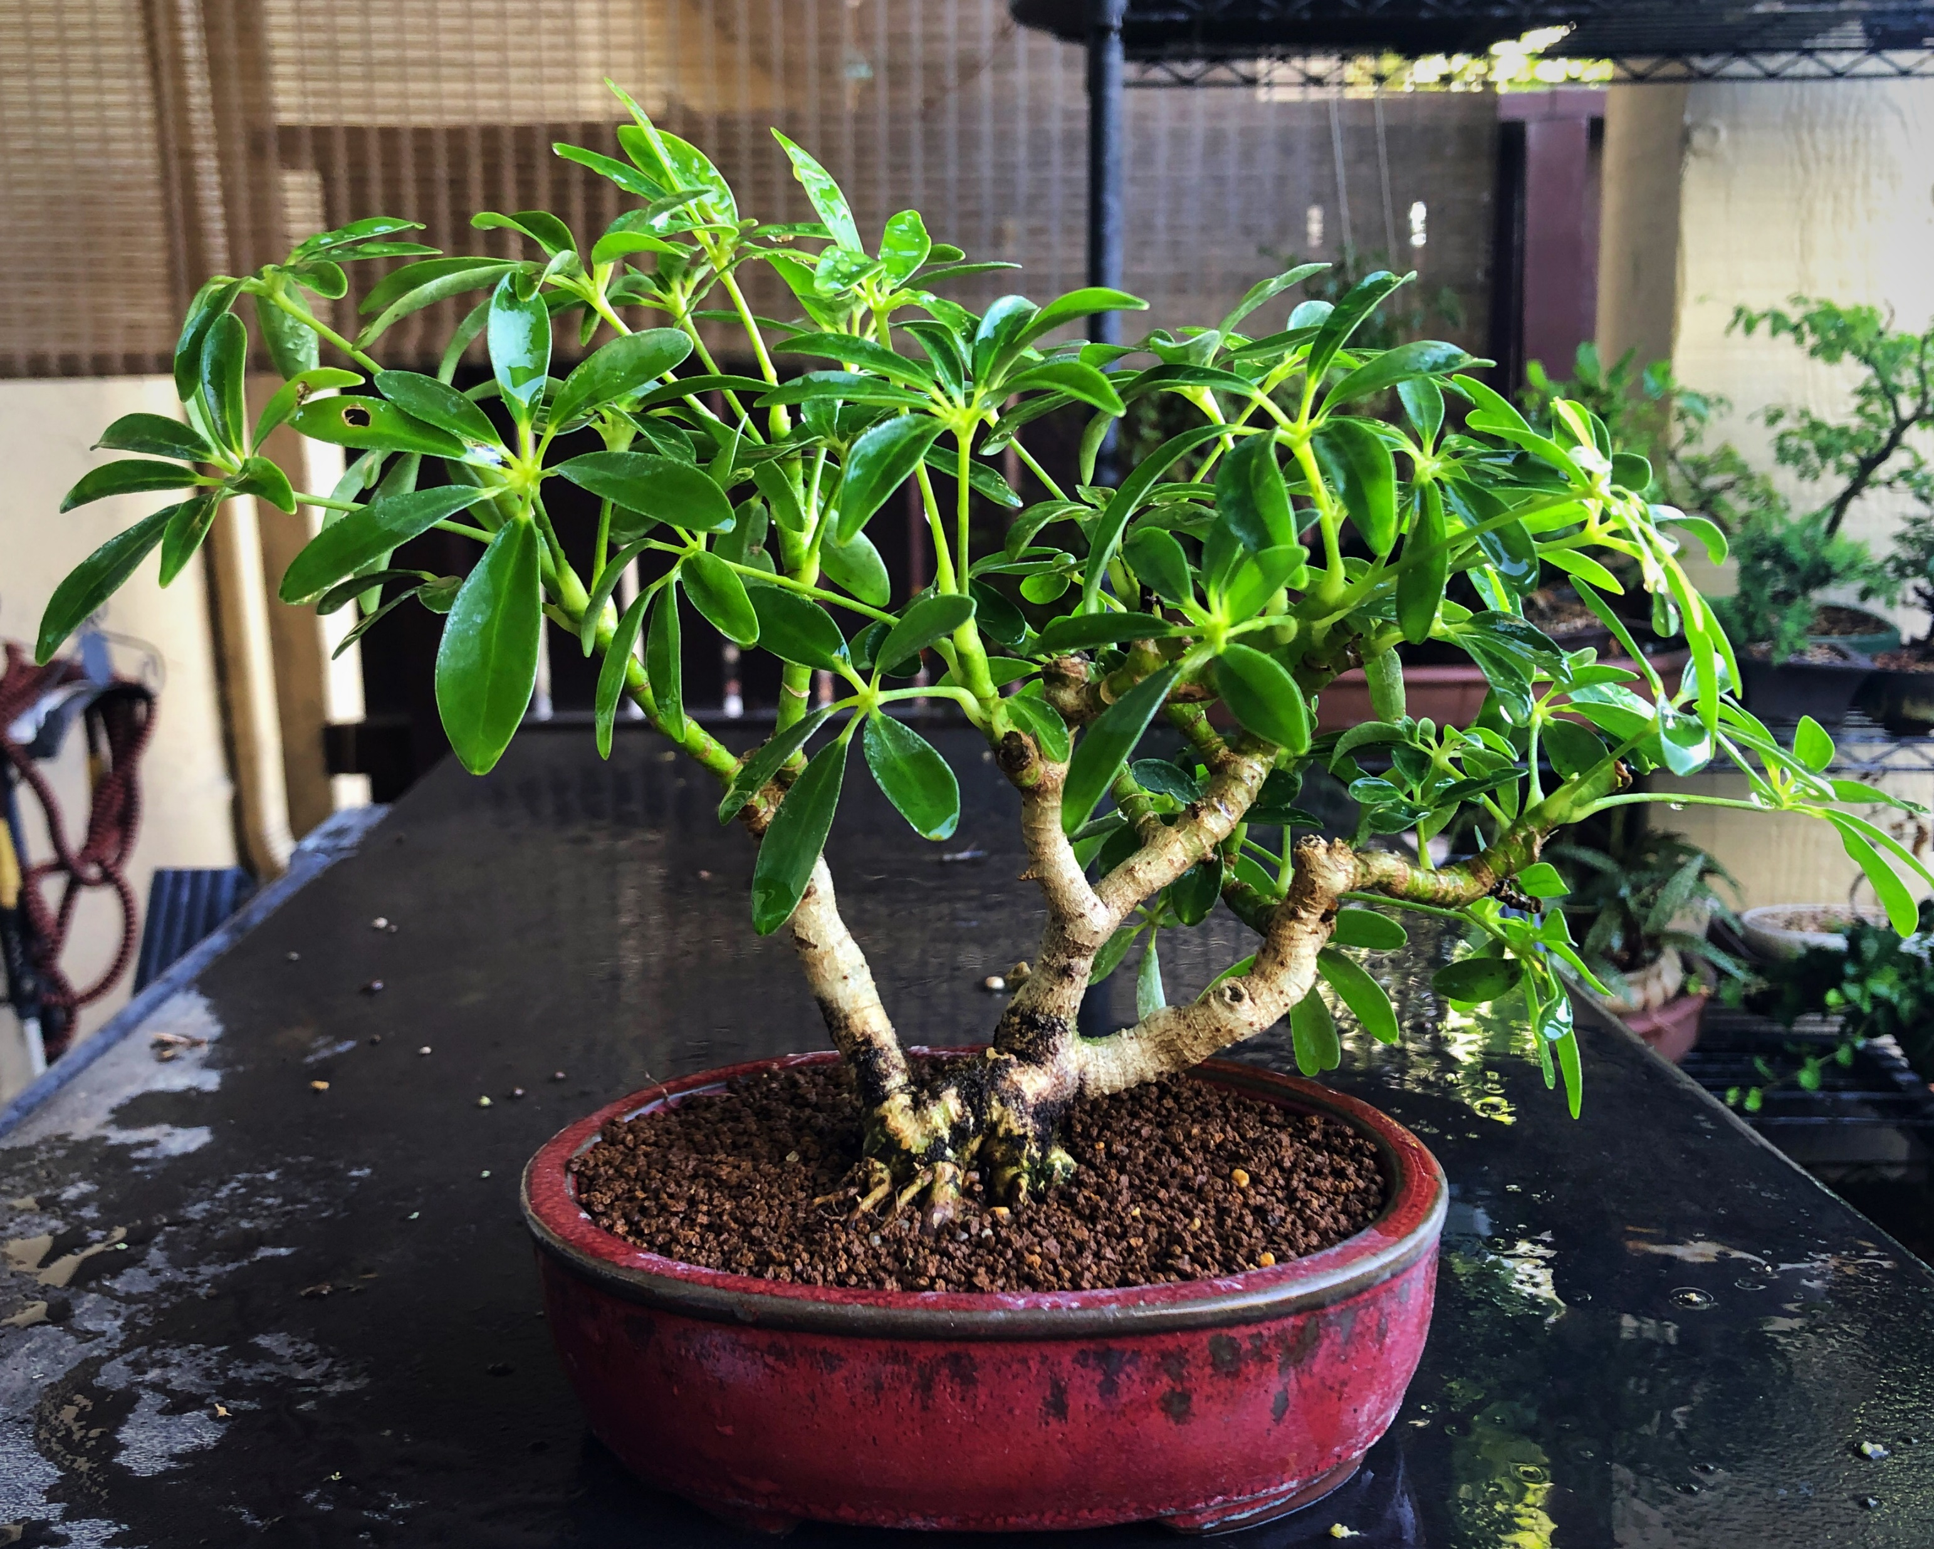
Schefflera Cutting
This was a cutting many years ago form the older plant, cuttings are placed in a jar of water outside and develop roots within a few weeks.

Slide 7
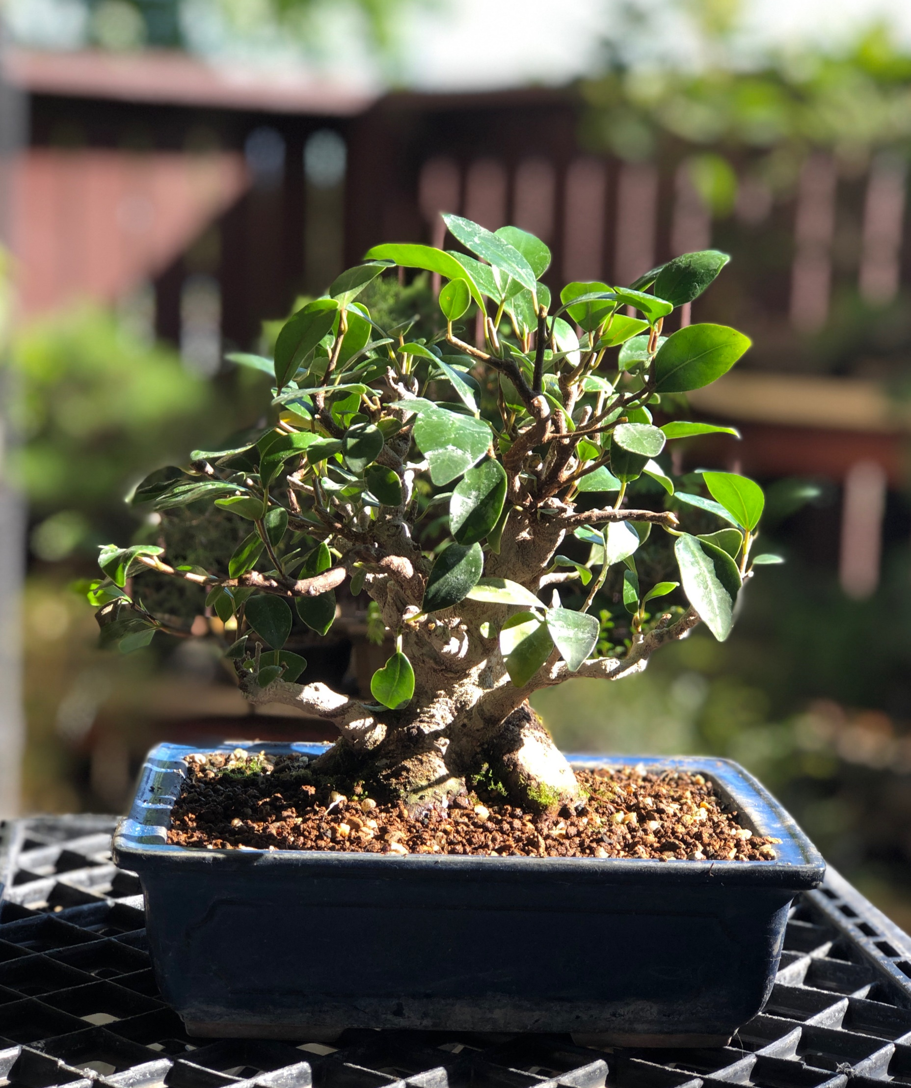
“Grafted” Tiger Bark
Referred to as Ginseng grafted ficus. It is not a ginseng at all. The flare of the nebari is taking a bit but I have converted the water holding leg roots into a new base.

Slide 8
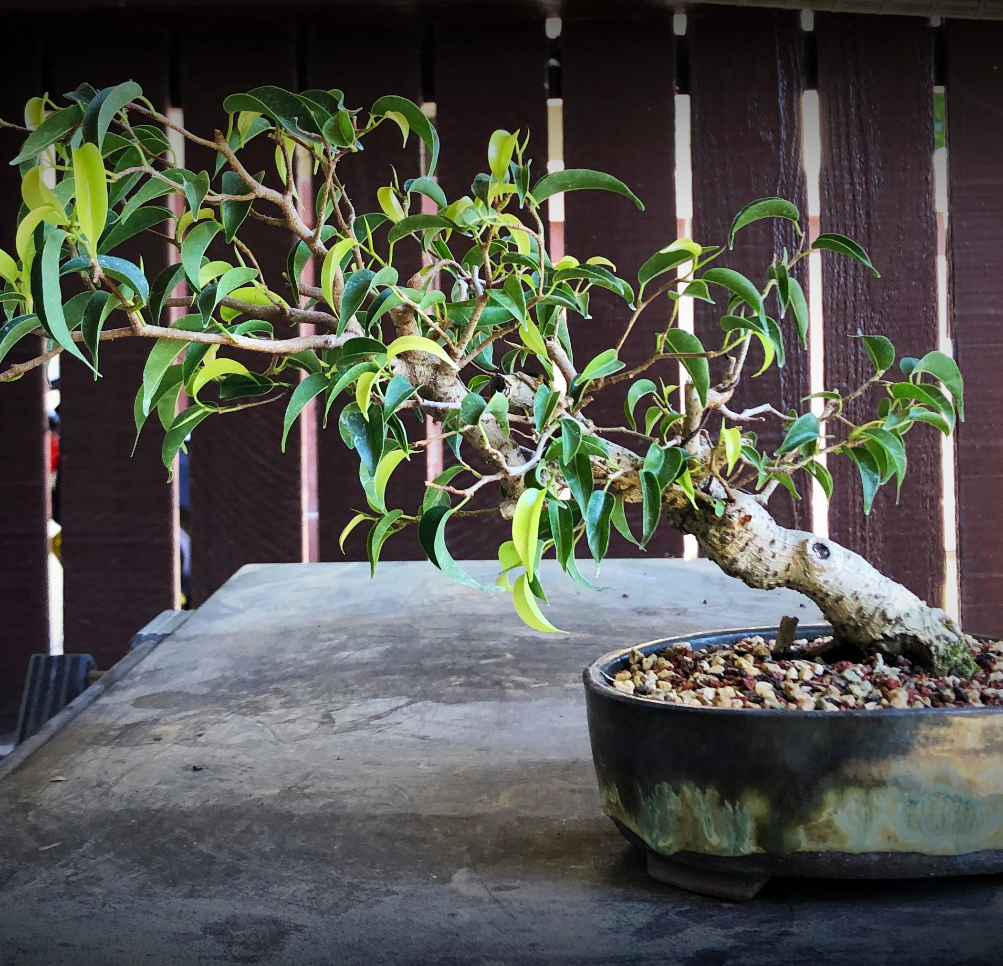
Ficus benjamina
One of the hardest ficus to maintain.
Very sensitive to light and temperature changes.

Slide 9
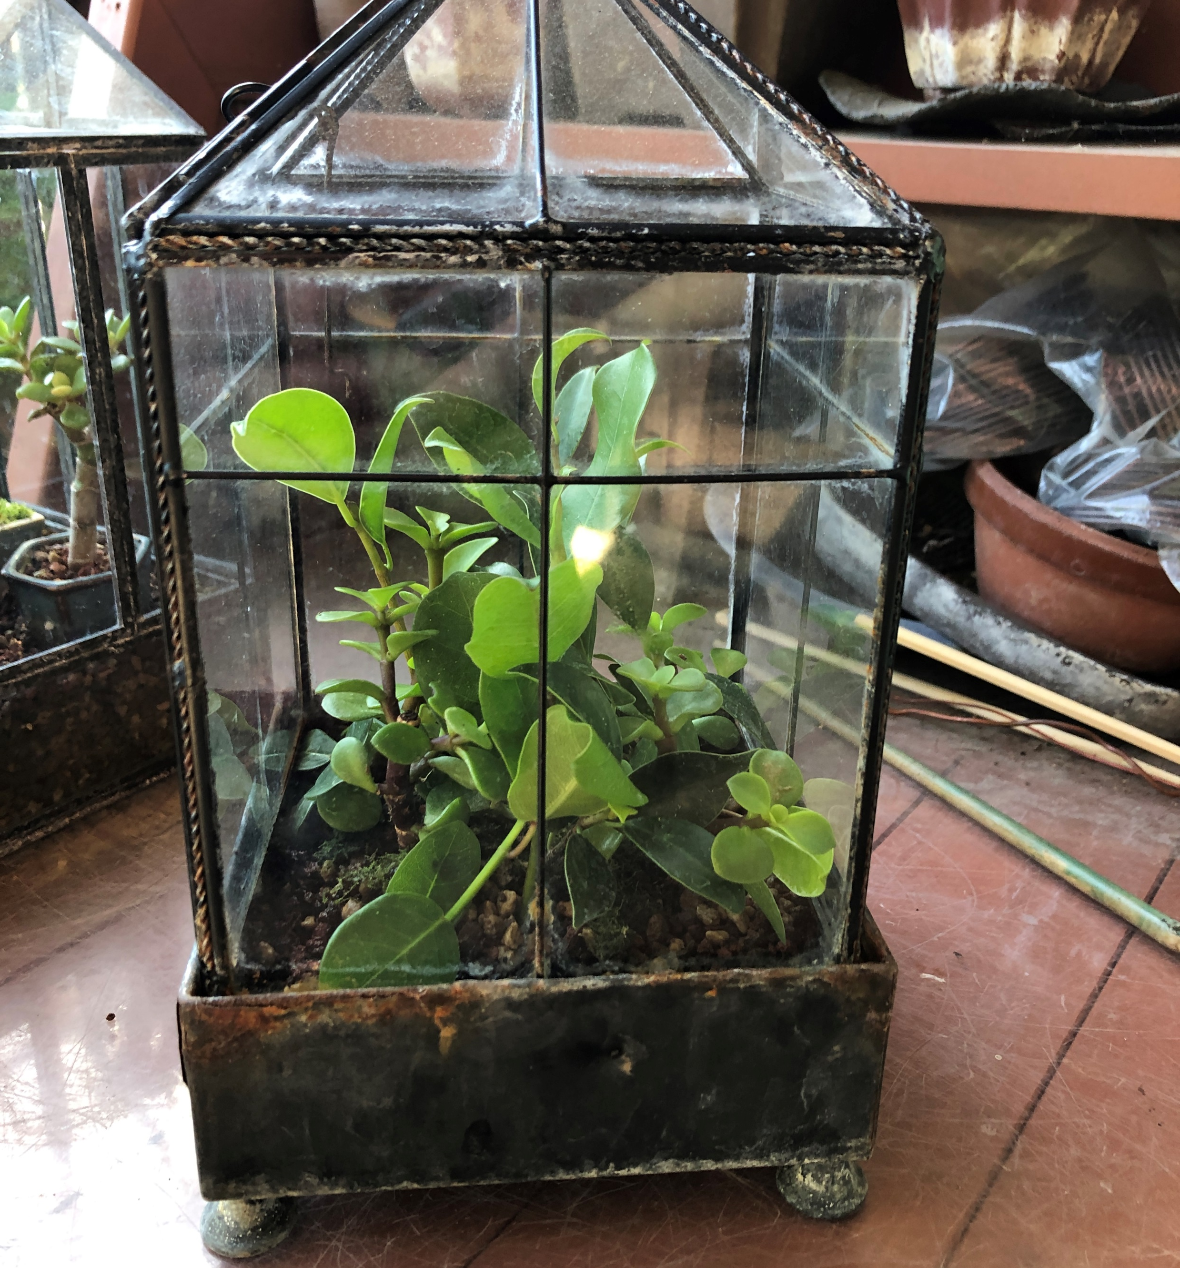
Cuttings in Bonsai Soil
These are cuttings I am starting directly in soil. The little green house is flooded periodically. It is kept warm outside with morning solar exposure. Roots develop aggressively.

Slide 10
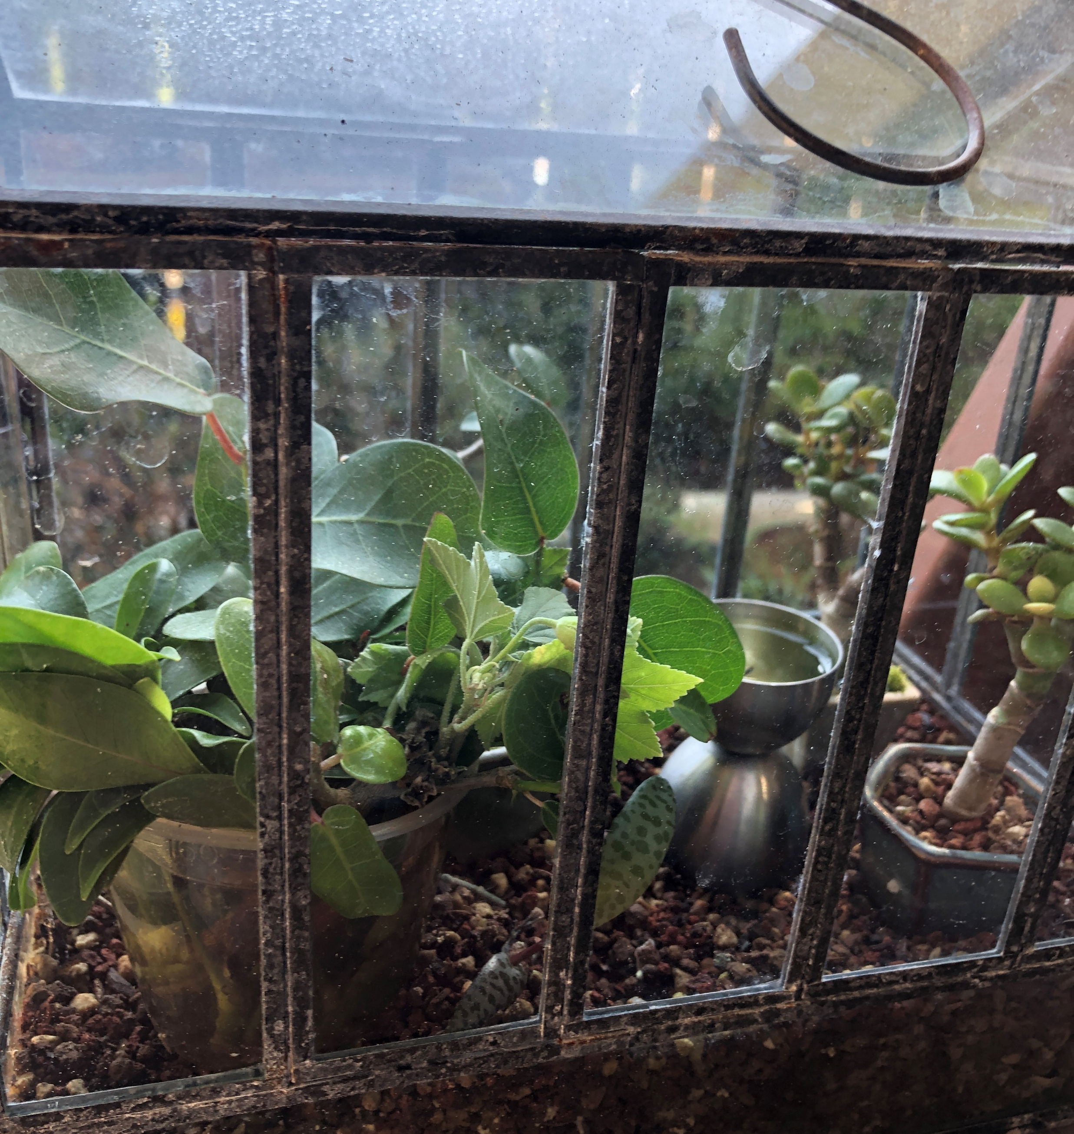
Cuttings in Water
Small plastic container of water in my second green house gets all kinds of cuttings. I have a large group of young plants ready for a plantings. Later this month I will develop some material. The small ficus will be trunk bound to create a larger trunk faster.
Note the miniature jade mame on the right.

Slide 11
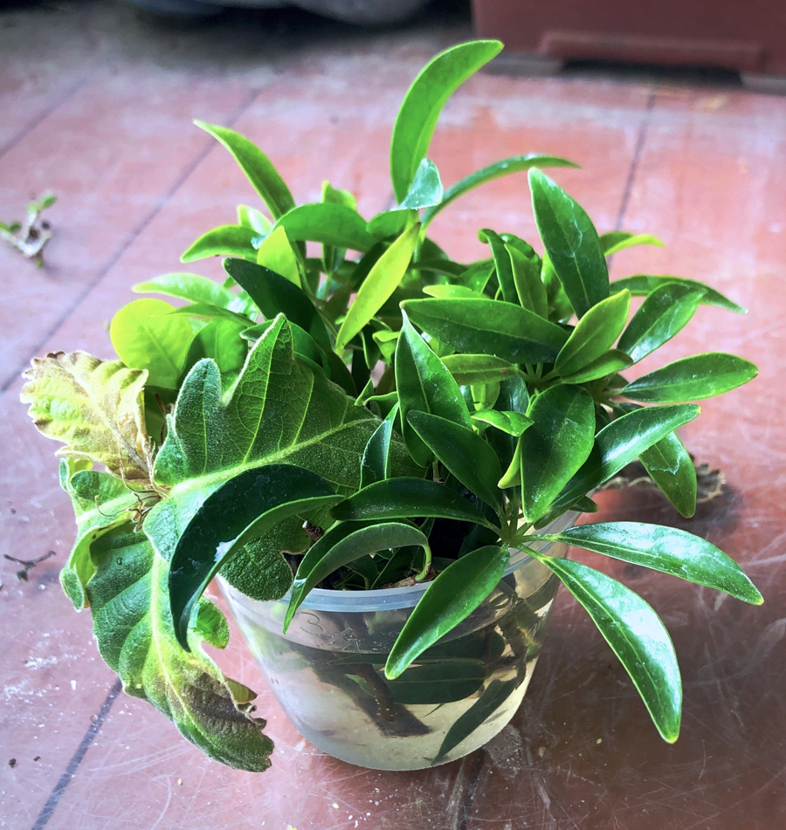
Easy Rooting for
Tropical Trees
They start out in a cup of clean water. Do not worry if the water gets green; all is well for root formation.

Slide 12
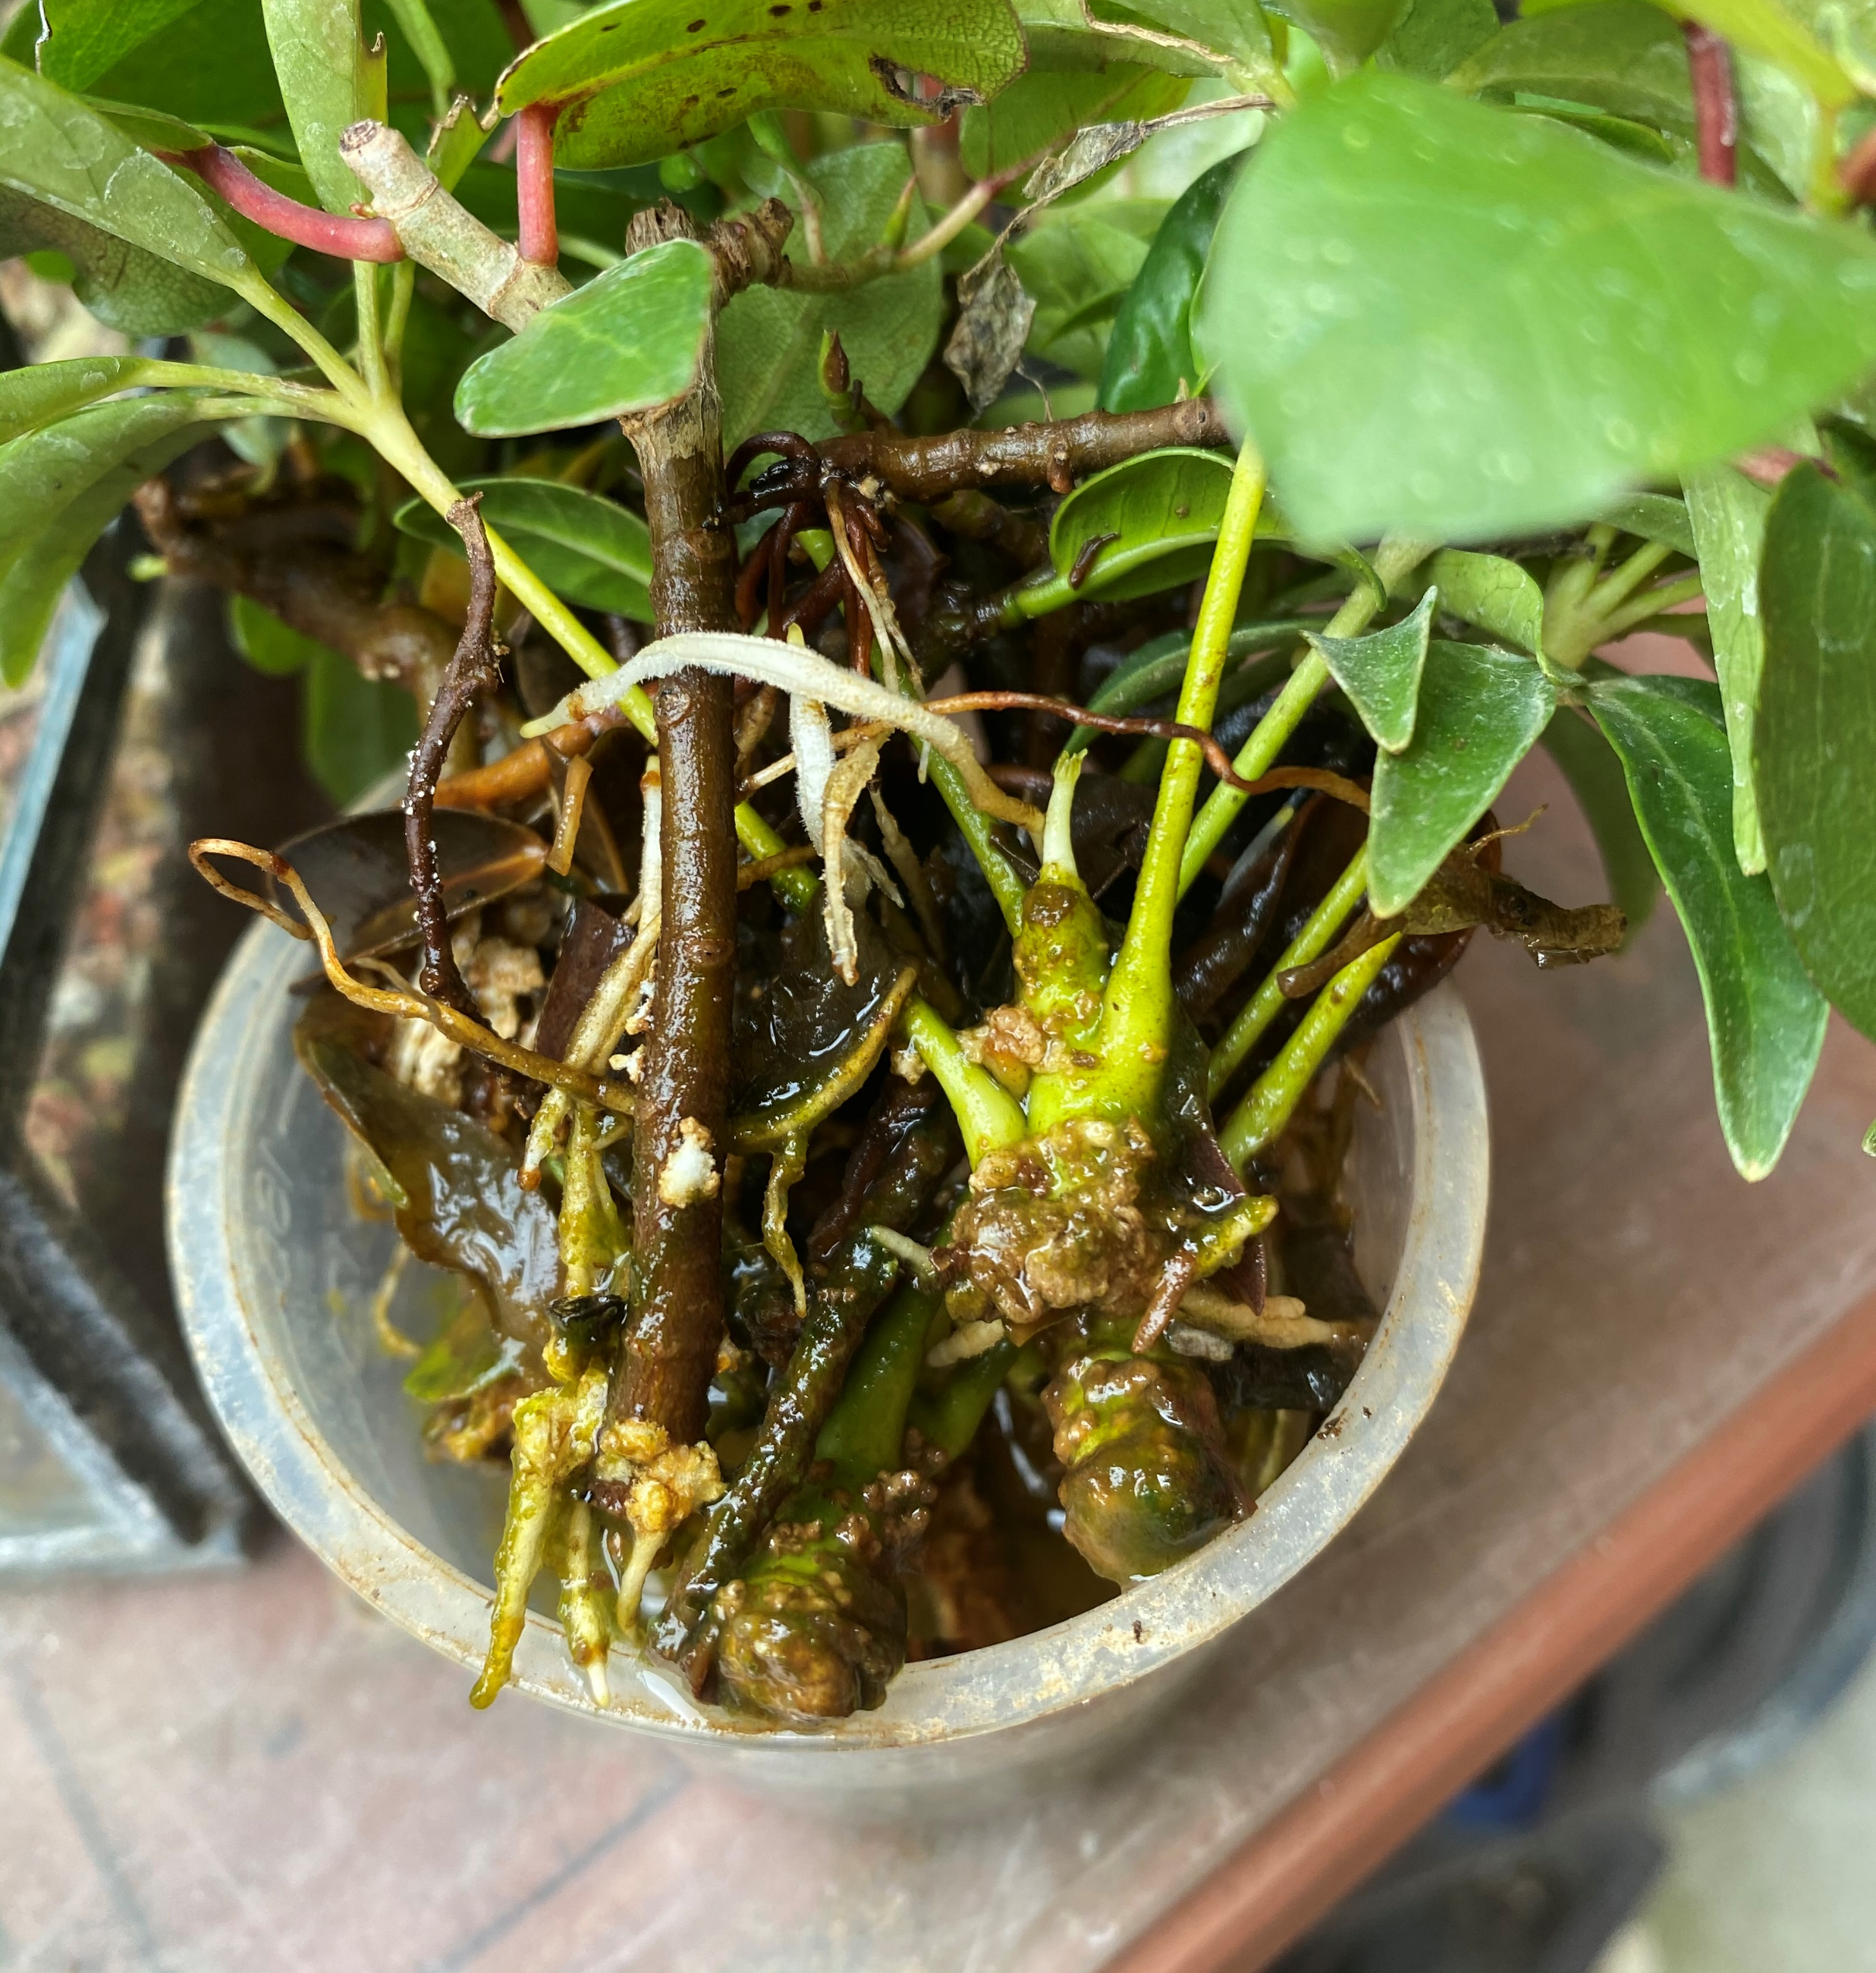
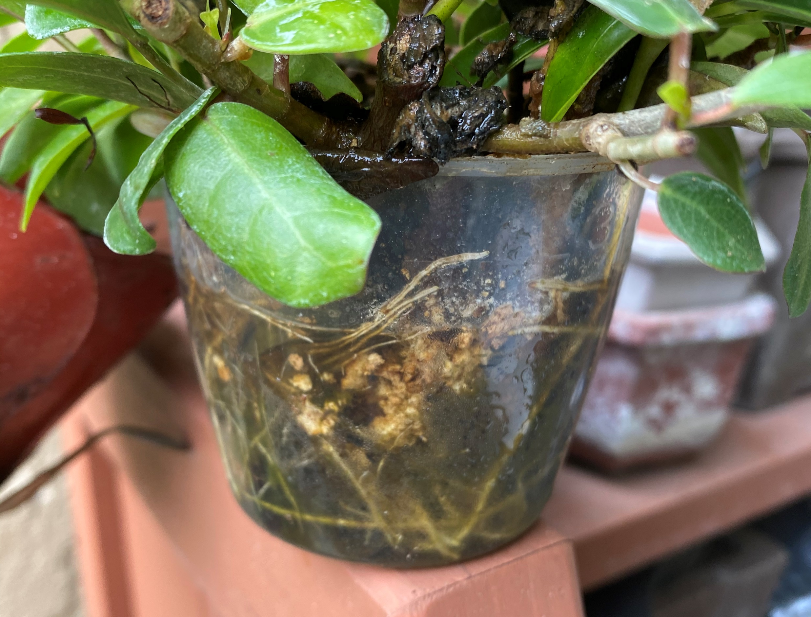
Root Forming in Water

Slide 13
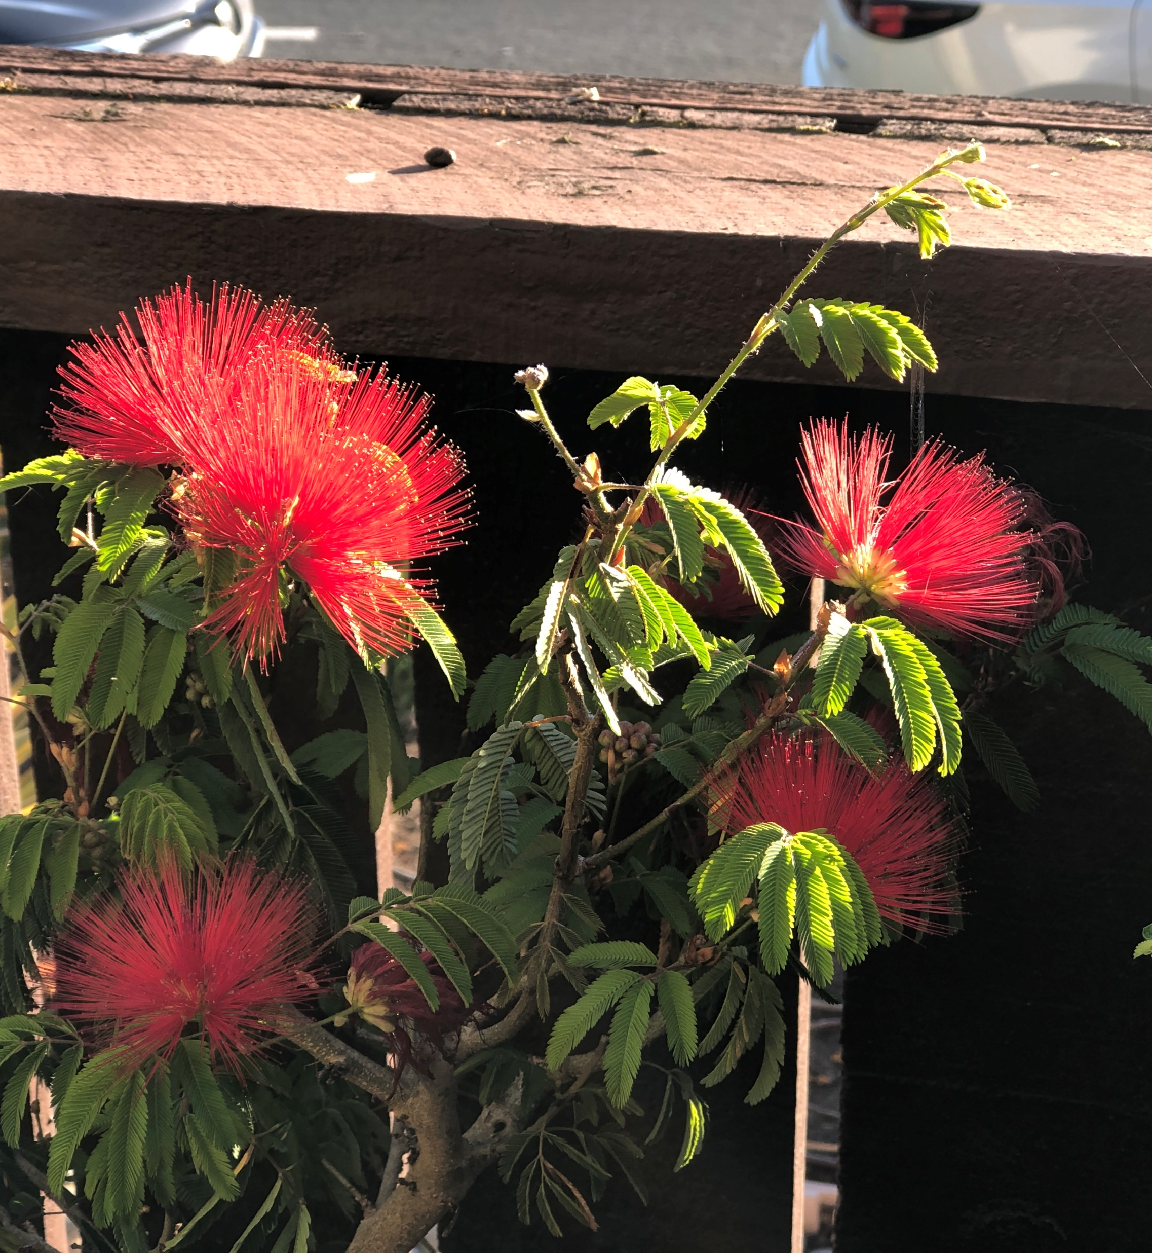
Peruvian Rain Tree
I am working with several interesting species:
Peruvian rain tree
Brazilian rain tree
Jacaranda
Portulacaria afra
These range from tropical/subtropical/and succulent species.

Slide 14
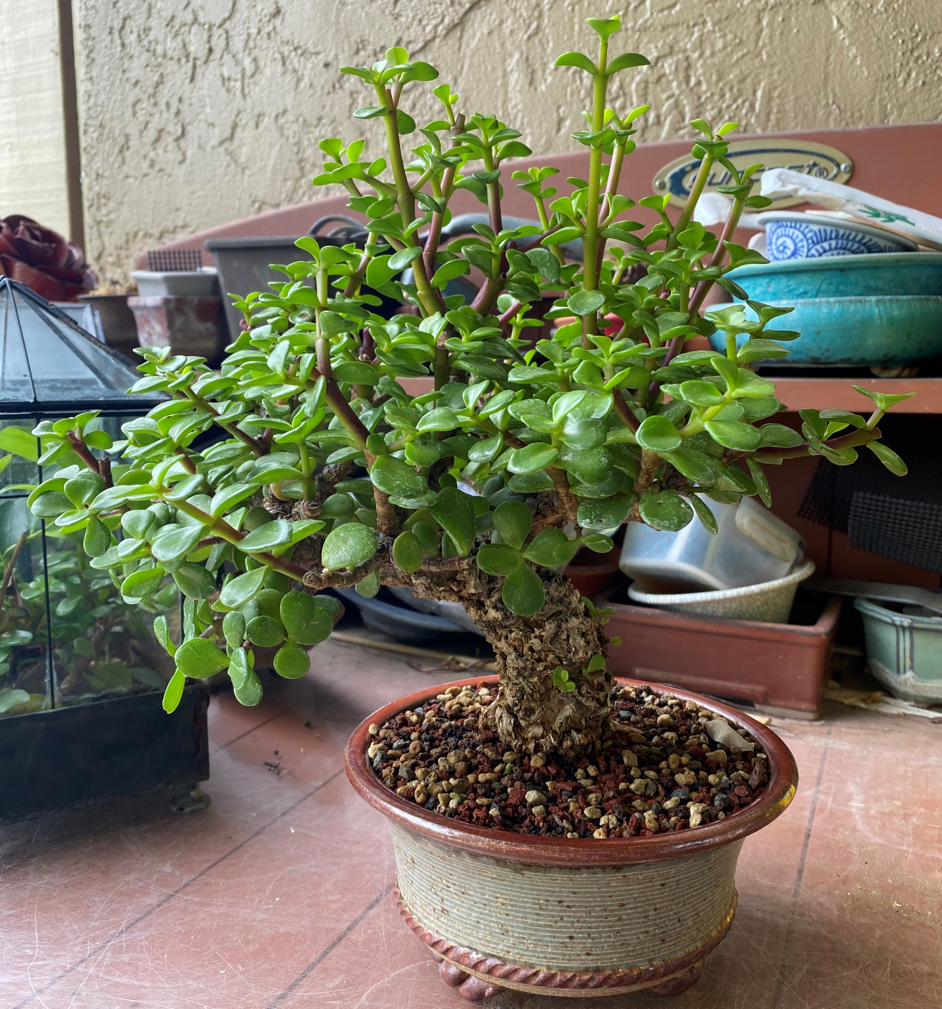
Portulacaria afra
This is cork bark variety

Slide 15
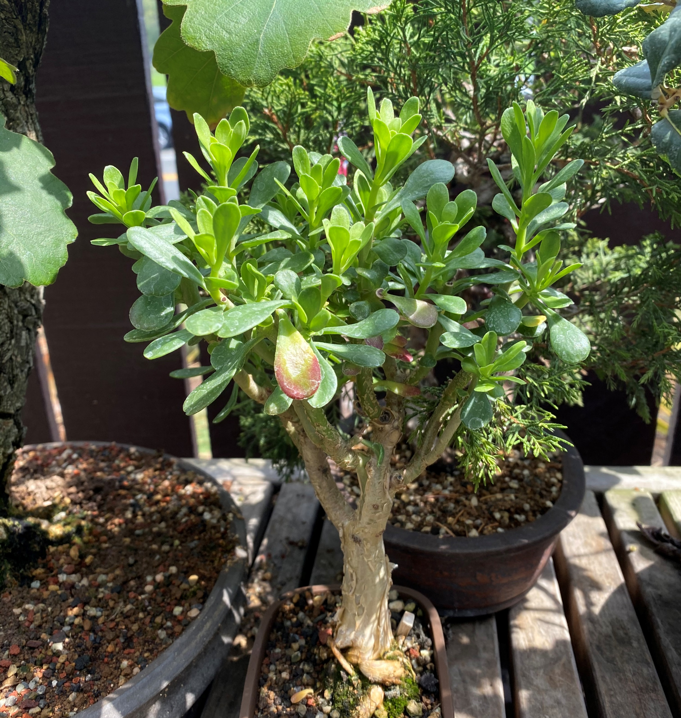
Portulacaria
“paper bark”
This little one was pickup at a club raffle table. It is difficult to keep in the winter, but I am finally getting robust growth after multiple cutbacks.

Slide 16
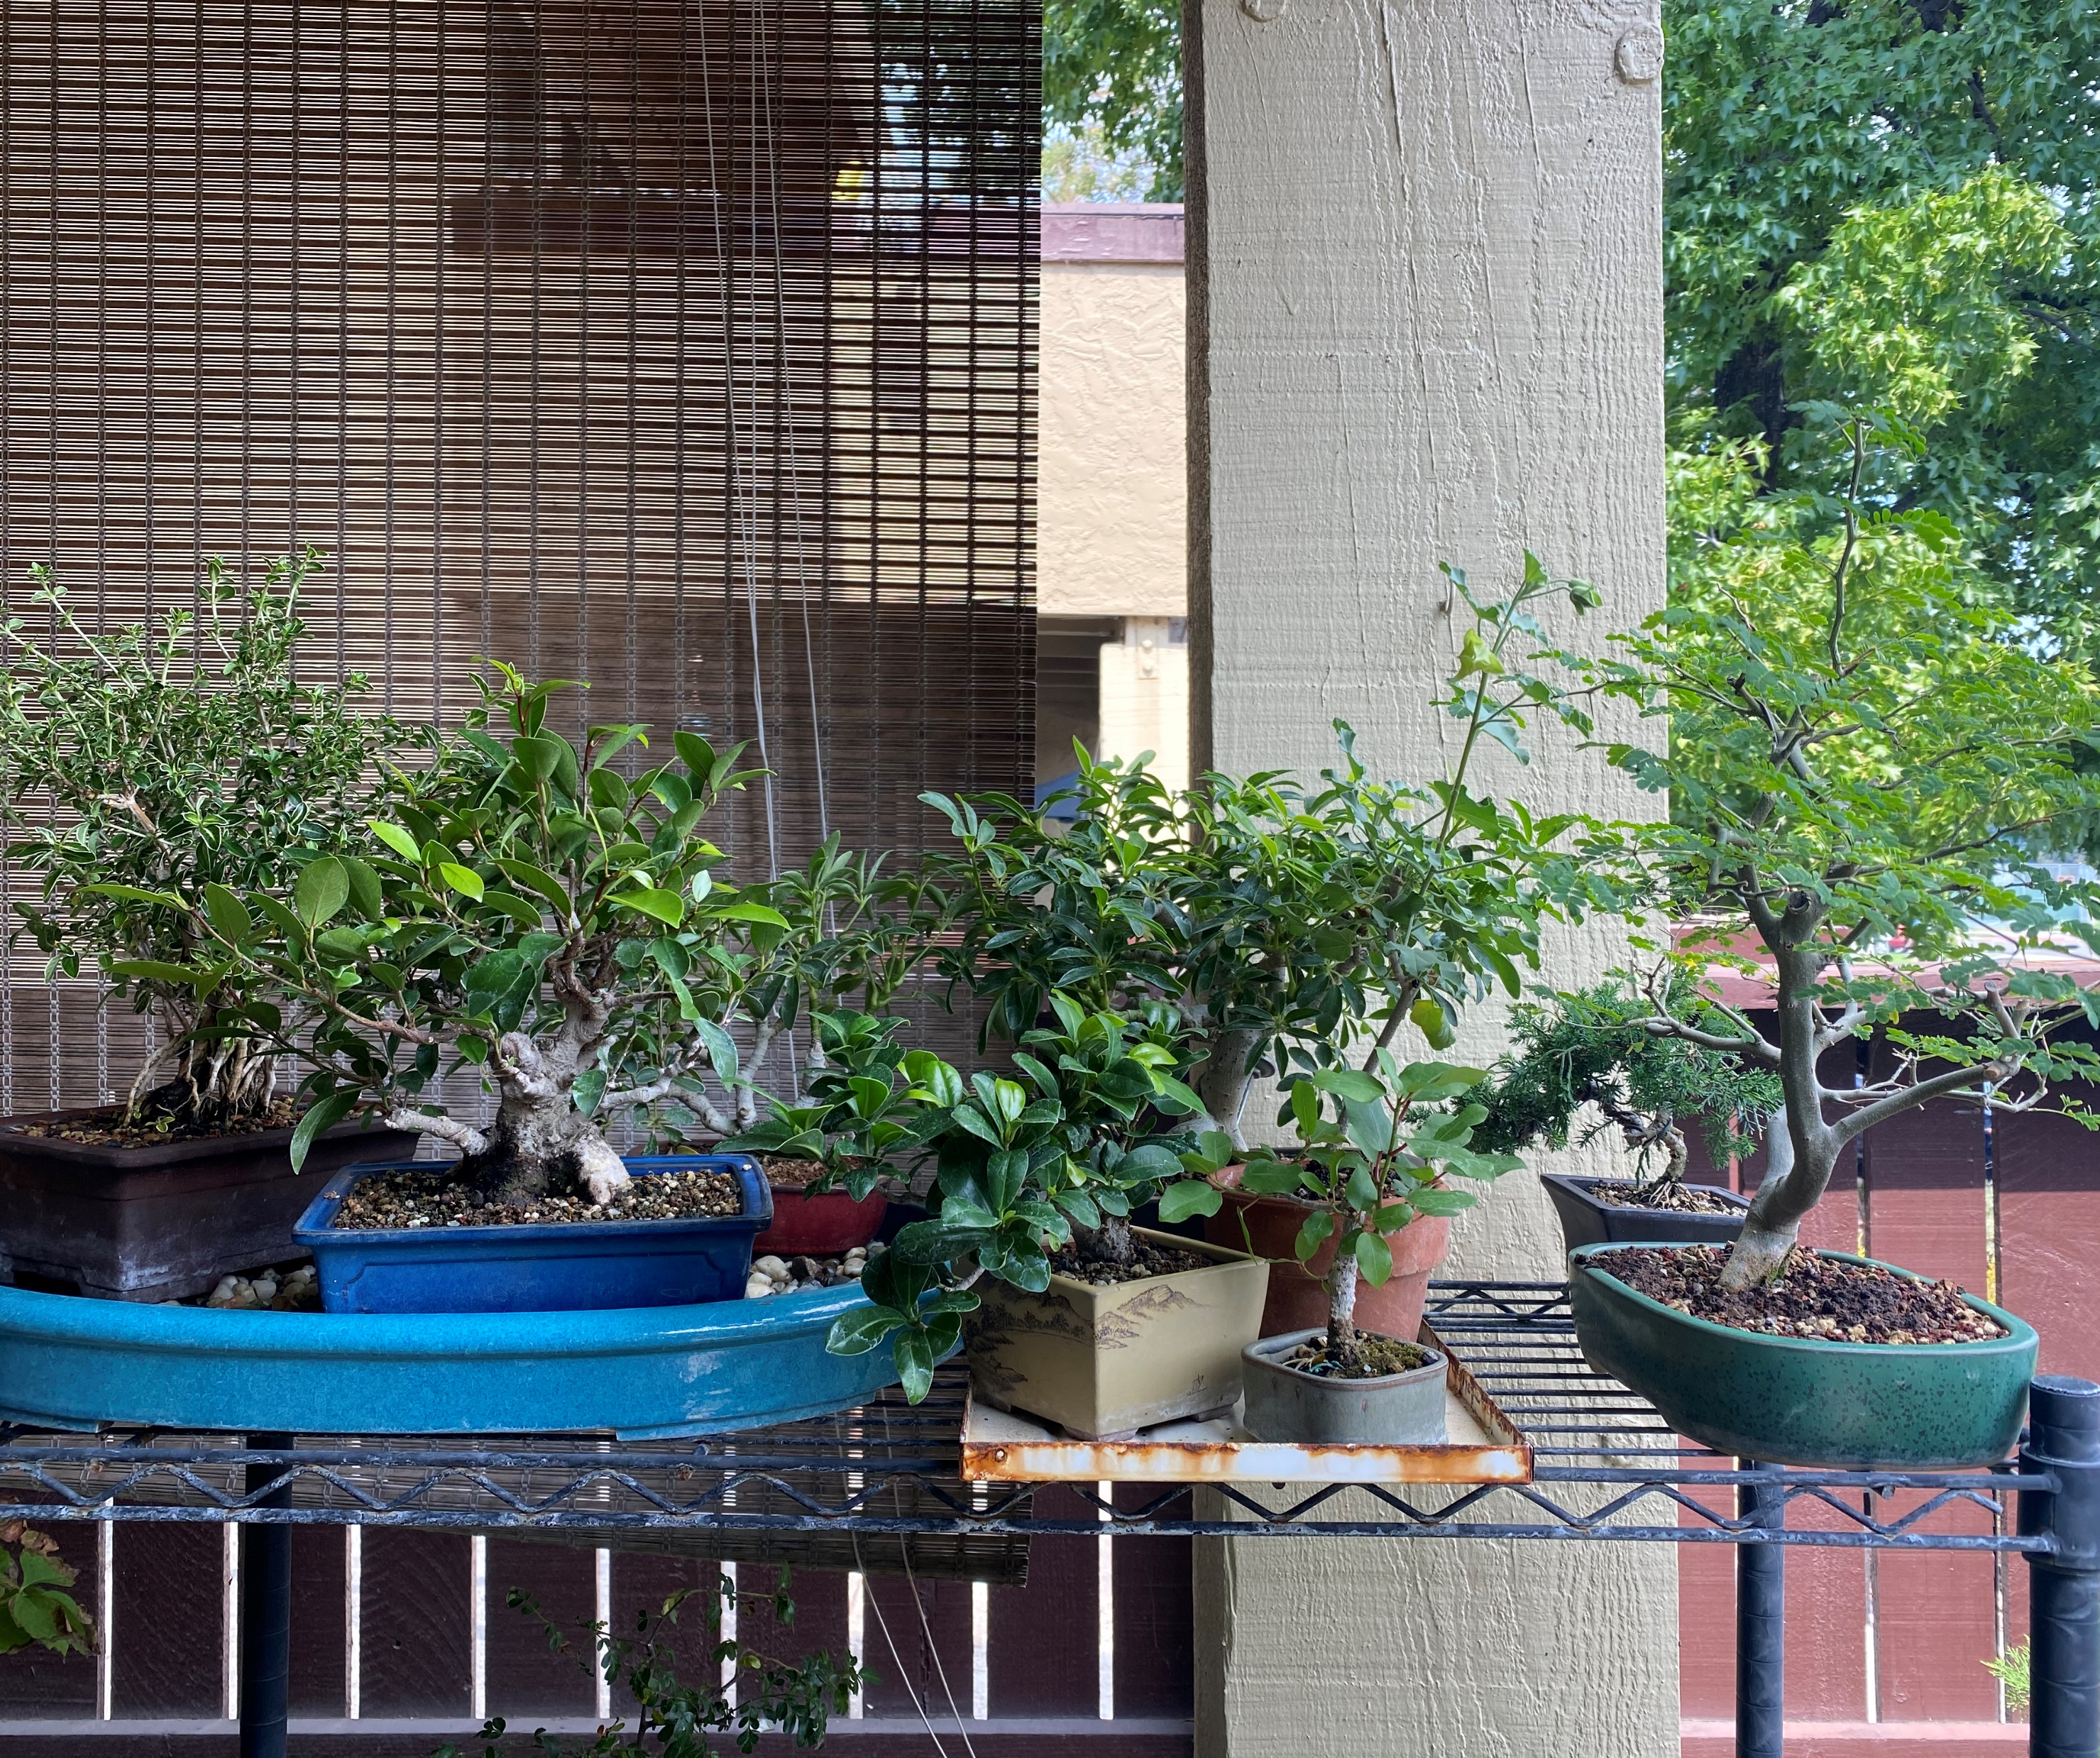
Top Shelf Tropical
The tropical collection moves around from racks to full sun on the benches. So many projects here including a serissa foetida in the back left. It is David Muir’s first tropical tree known as the stink tree due to the smell from cut branches or roots. It is be developed as exposed root style.

Slide 17
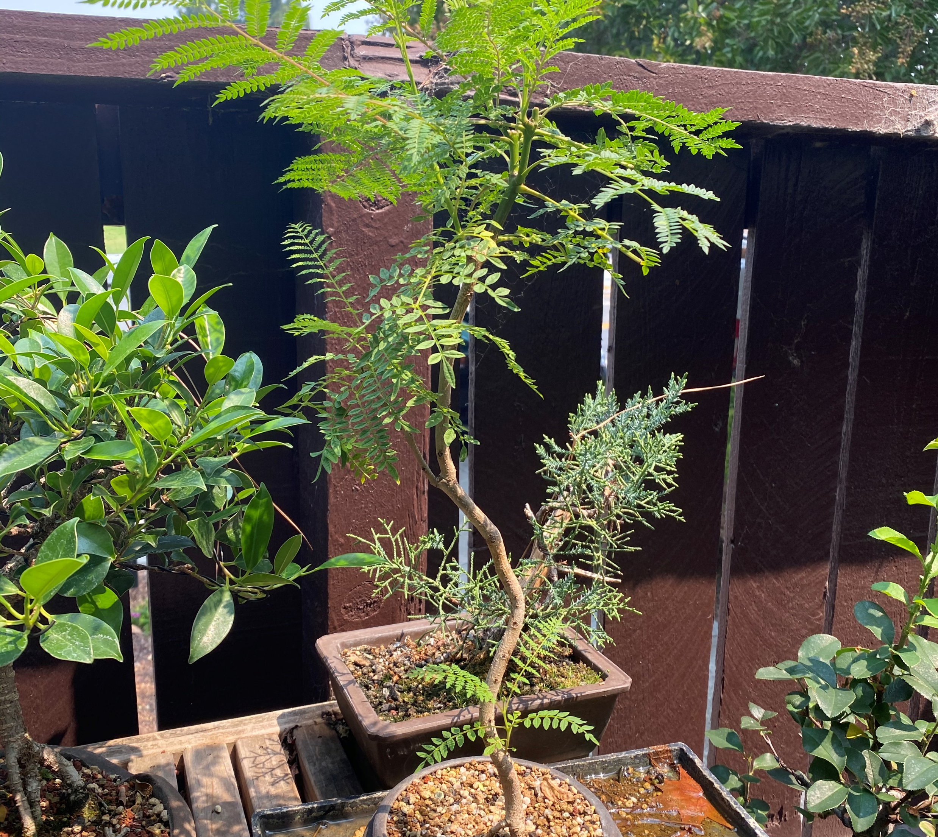
Jacaranda
This Jacaranda is from a seedling found at USGS between pavers. In a few years I added movement to the trunk and now working on the canopy. This horticulture of this tree is different. Springtime is its winter; it will lose its leaves and bloom late Spring.

Slide 18
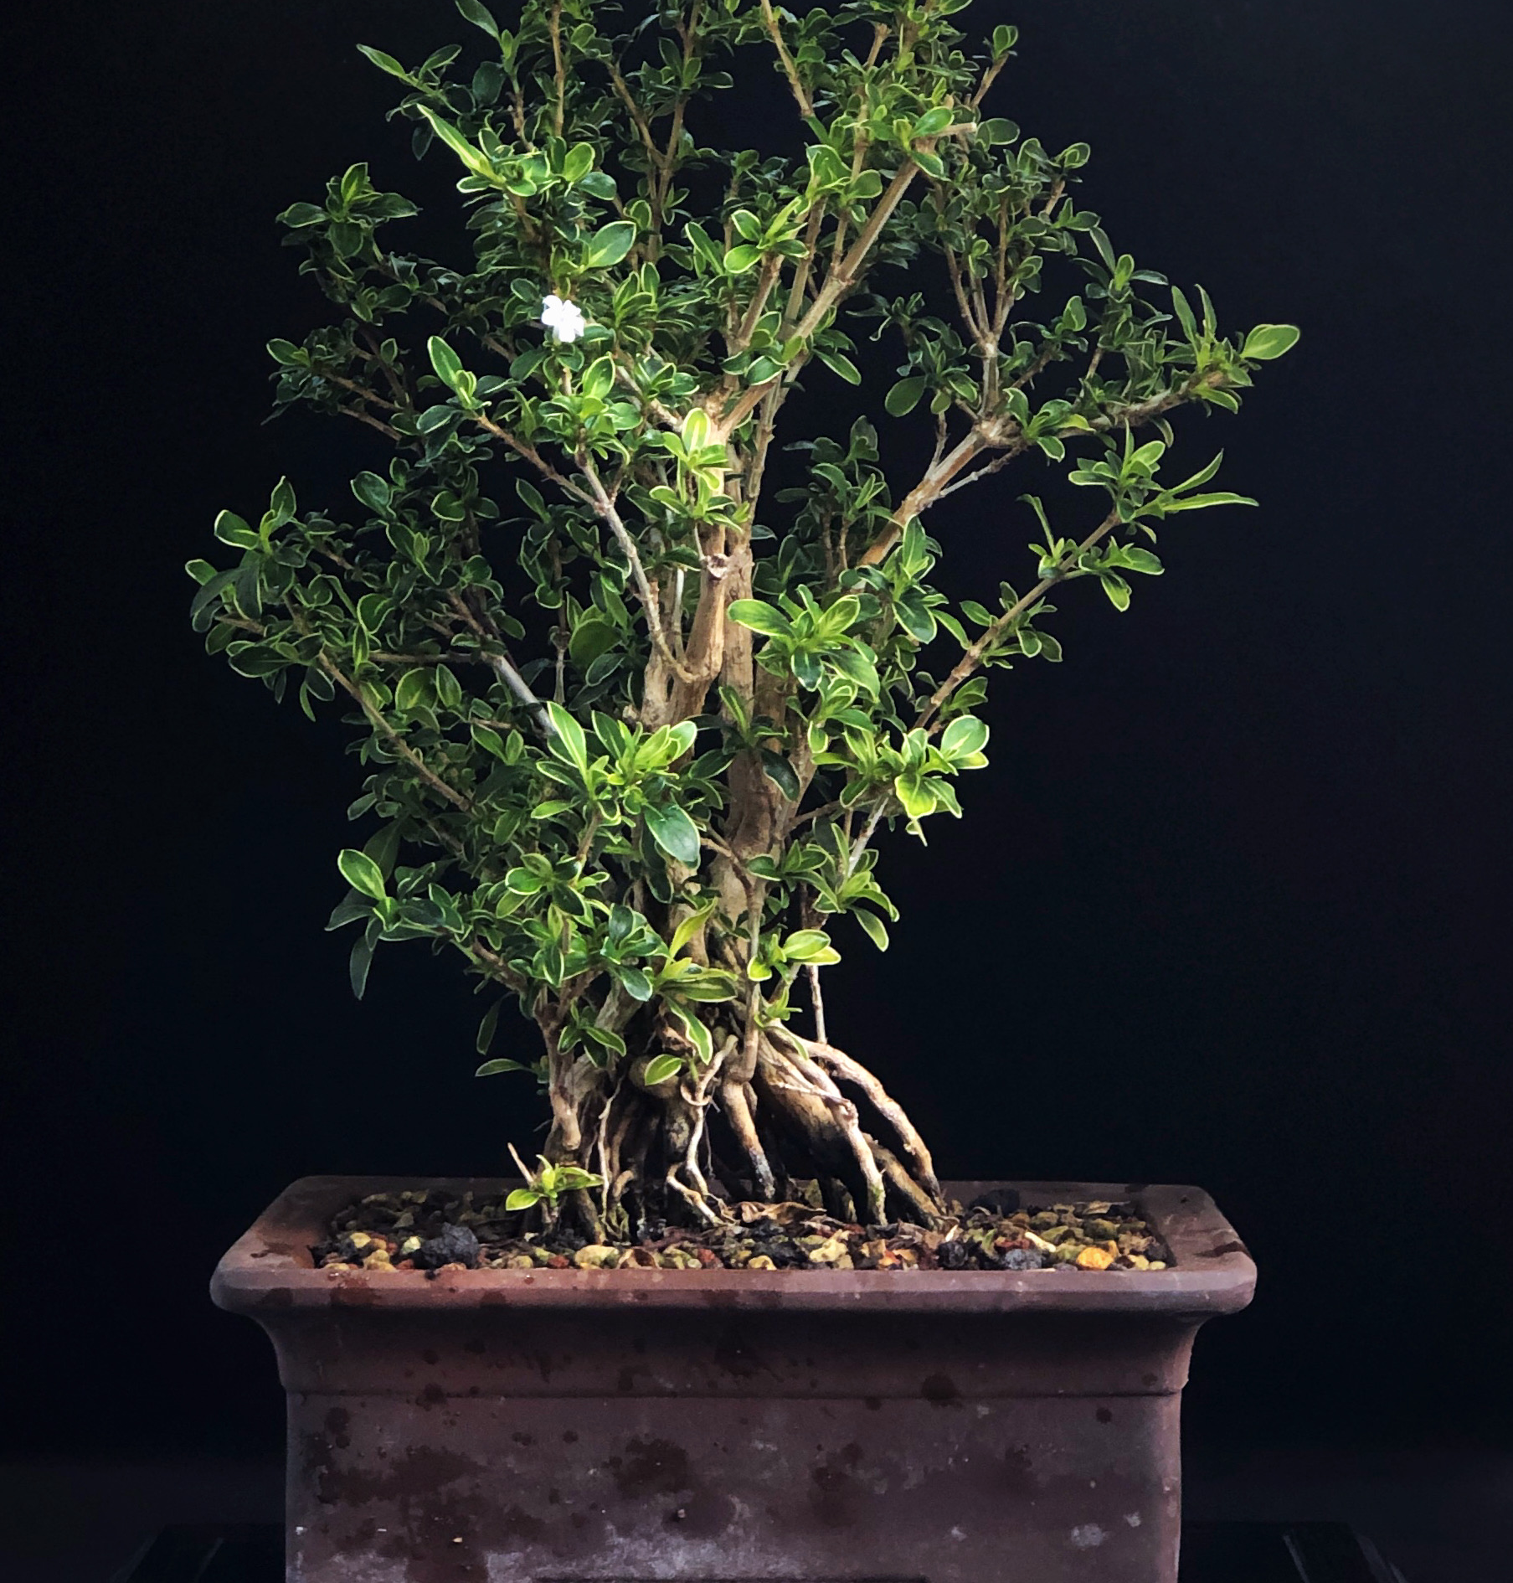
Serissa foetida
Exposed root Serissa. Since this picture was taken it has bloomed extensively and been cut back. We have wire branch separators inside moving
the trunks.

Slide 19
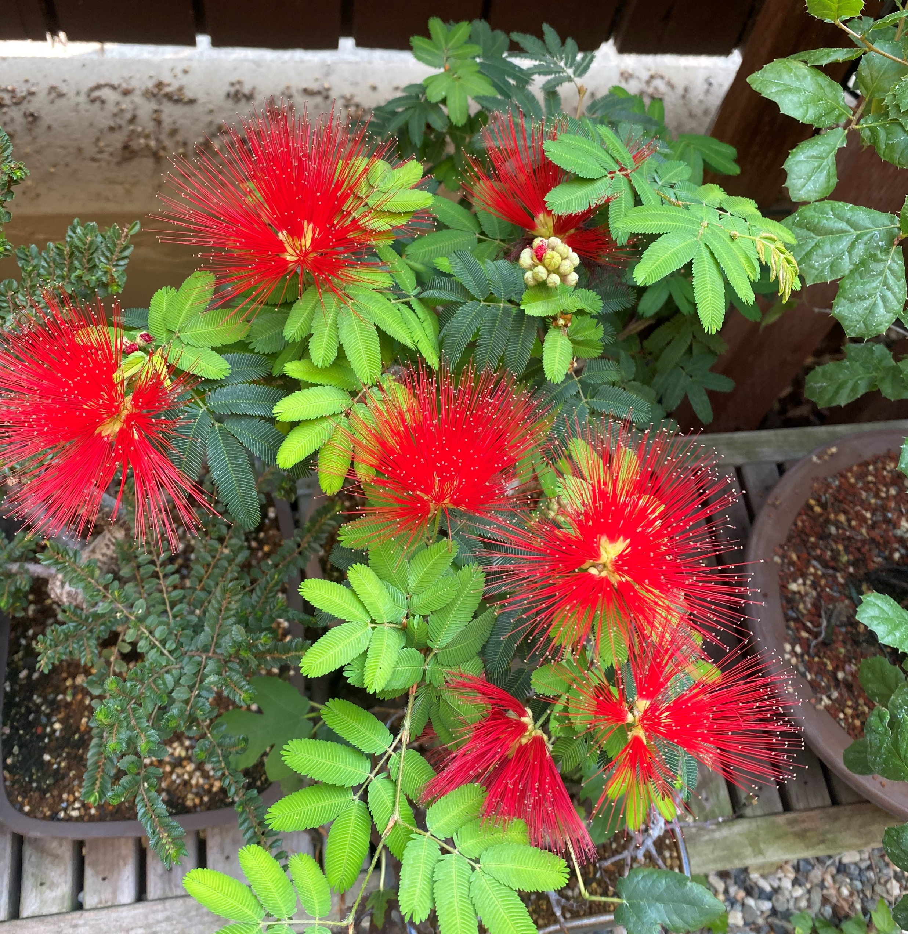
Late Summer Color
After their initial late spring cut back these trees are exploding with fireworks of color. This will make a great display some day. Branches are sensitive to wire, but I am learning to keep it loose.

